Slide 1
The Case for Memory Segmentation
Alex Markuze, VMware
Notes:
Hi
Make the case for adding a new attribute to memory pages.
Which facilitates assigning roles to pages.

Slide 2
Background
DMA Aware Malloc for Networking
(ASPLOS’18)
Memory Allocation for I/O
(Netdev0x15)
https://netdevconf.info/0x15/session.html?Rethinking-Zero-Copy-Networking-with-MAIO
Notes:
To make this case I will talk about two projects.
DAMN - how to provide DMA security without giving up on performance, present at ASPLOS’18
MAIO – My current project. Rethinking zero-copy techniques. Find the full talk on youtube.

Slide 3
DAMN
DMA Aware Malloc for Networking

Slide 4
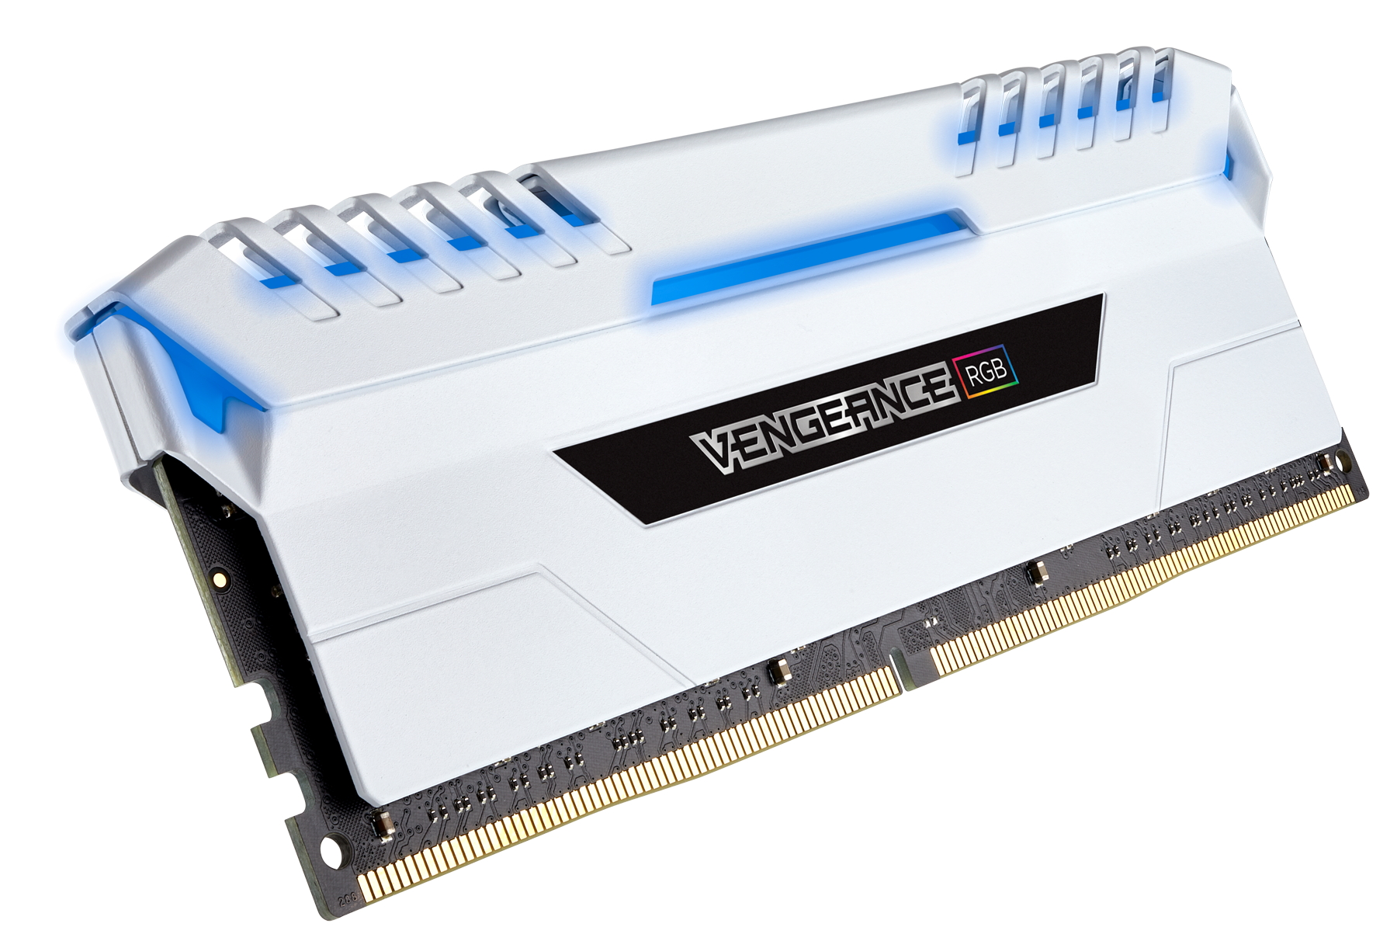
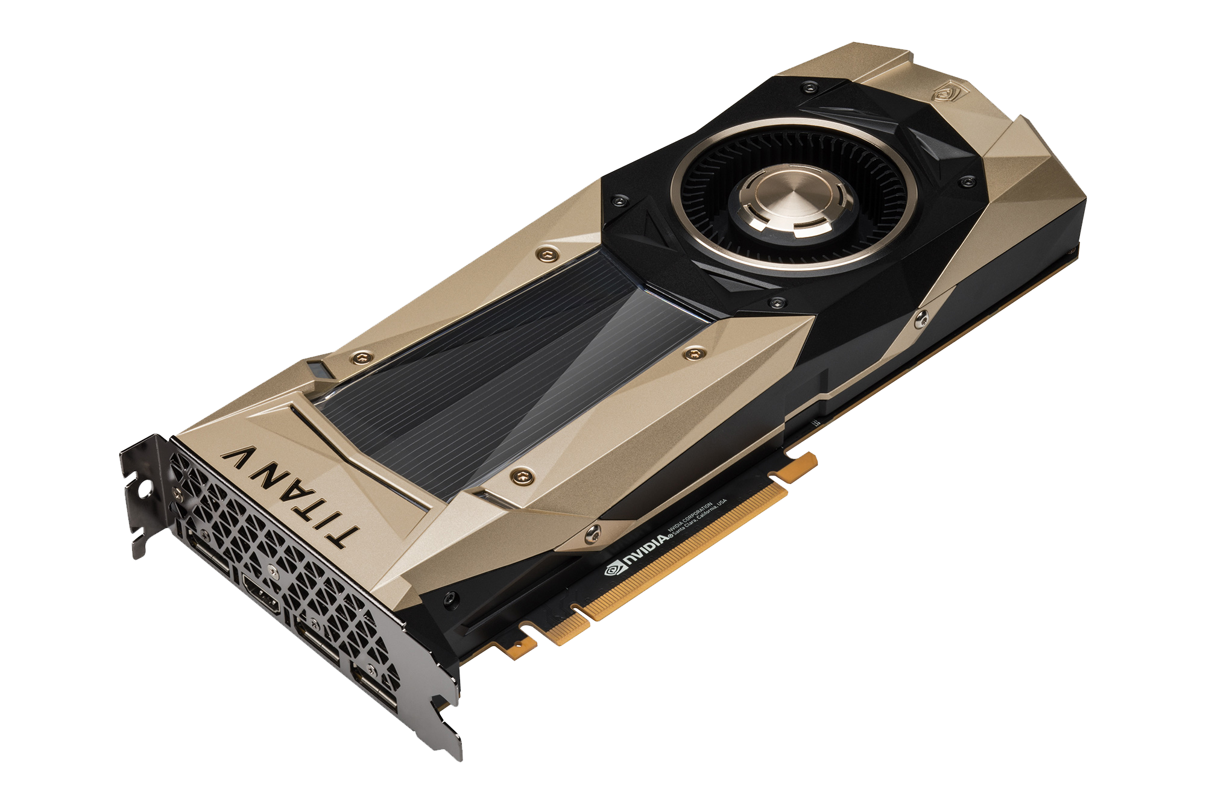
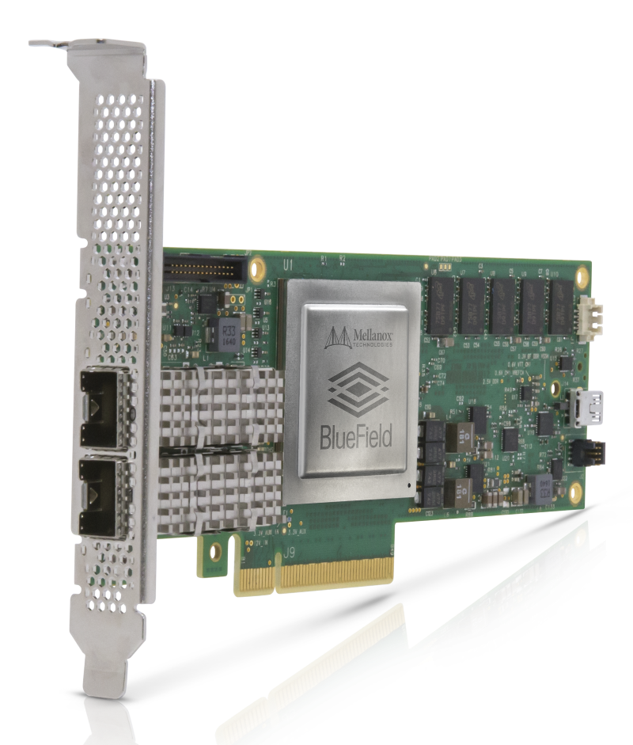
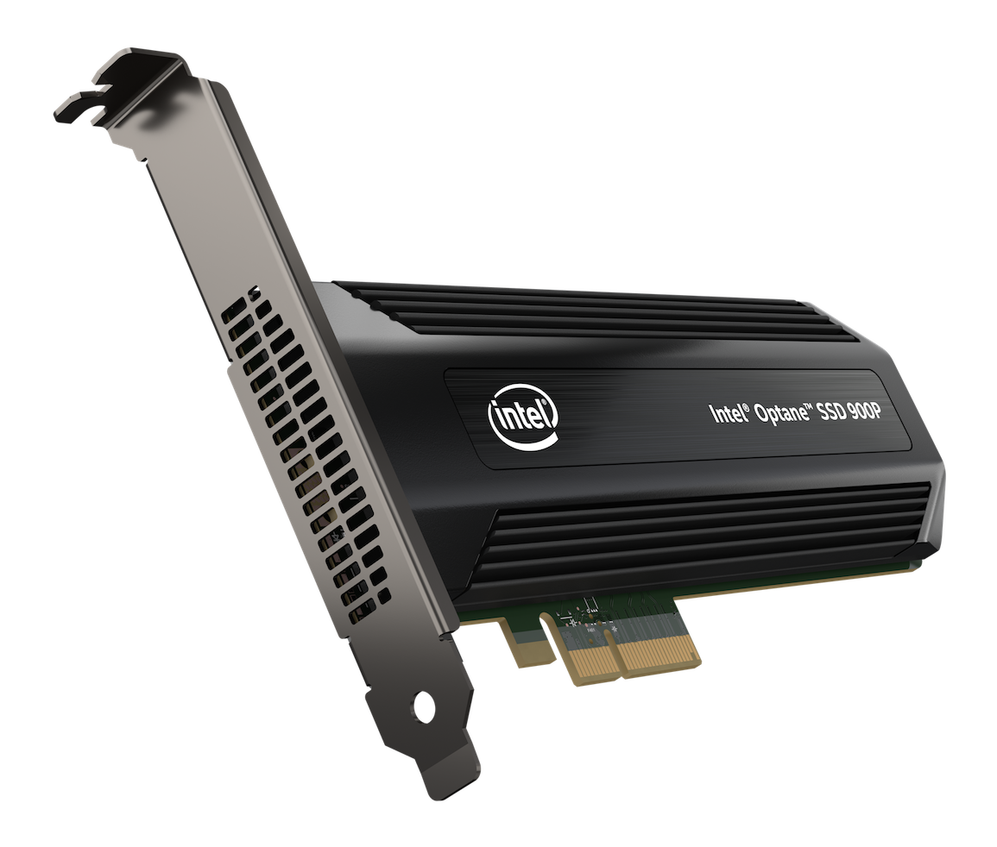
DMA
Background
Notes:
DMA, or direct memory access. Its when, an attached device can access the main memory without involving the cpu.
Thats Devices like GPUs, SSDs and Network Cards . These devices have their own memory and cpus(1) and can therefore run their own code.(0:35)

Slide 5
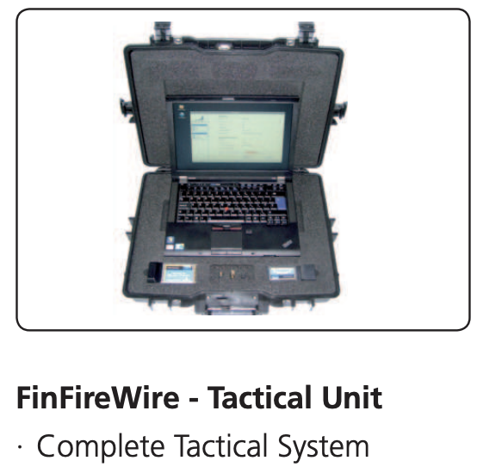
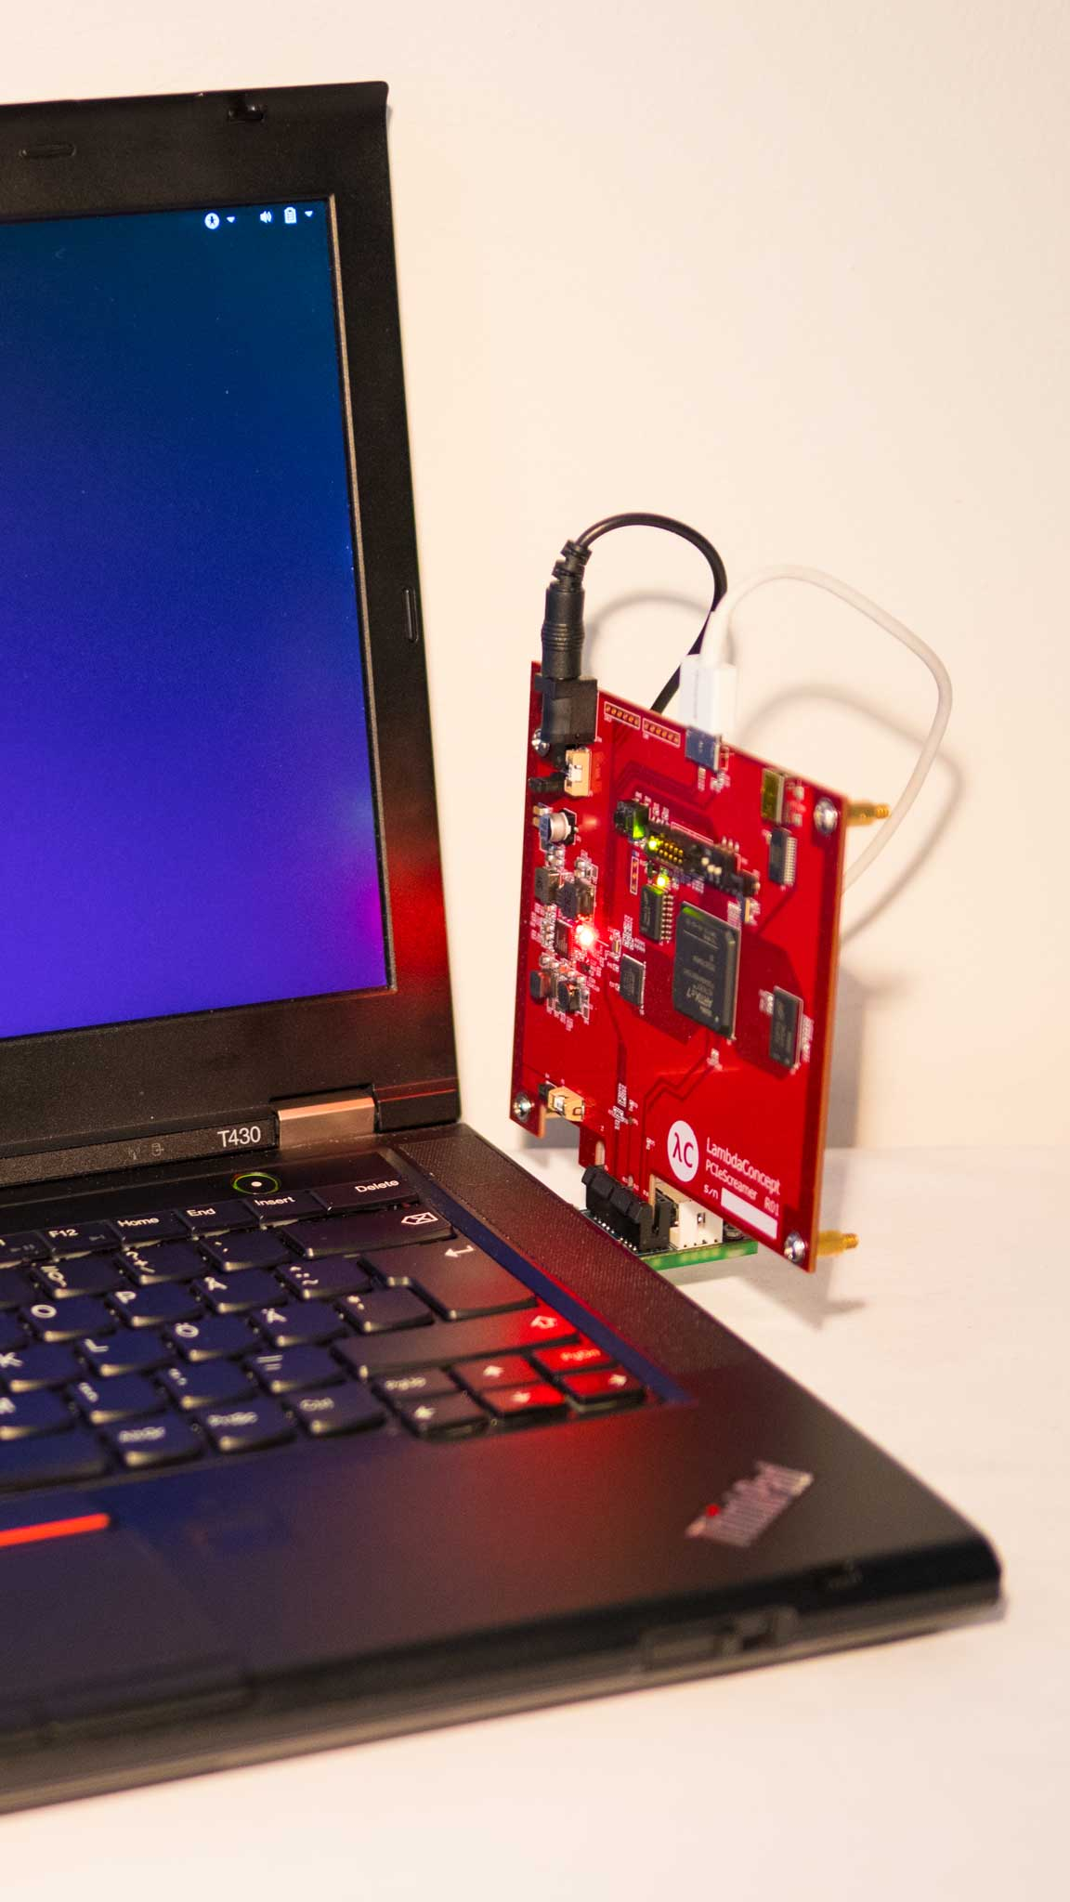
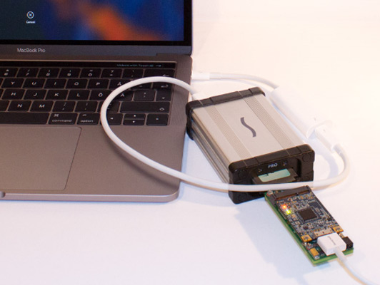
DMA Attacks
Background
A Malicious, DMA-Capable device compromises the system.
FinFireWire
https://wikileaks.org/spyfiles/files/0/299_GAMMA-201110-FinFisher_Product_Portfolio-en.pdf
PCILeech
https://github.com/ufrisk/pcileech
Notes:
But DMA can lead to DMA attacks. When, a malicious device compromises a system by modifying memory that is shouldn’t. One notorious example is this FinFireWire unit(+). Basically a Lenovo Thinkpad with a firewire adapter.

Slide 6
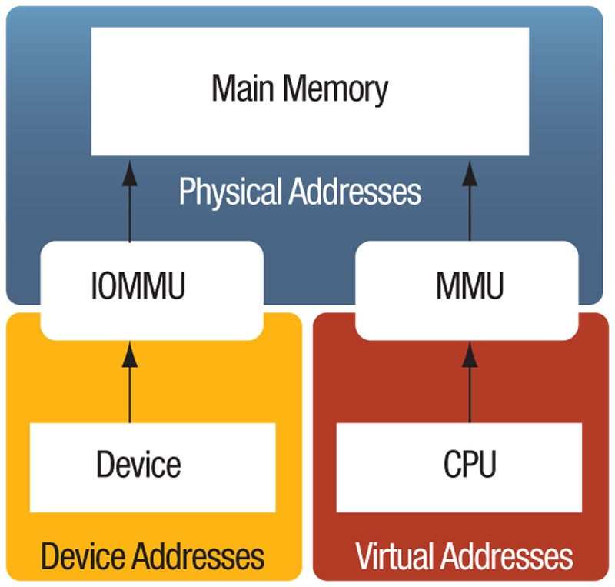
IOMMU
Background
Address Space Isolation (IOVA).
Restricts Device access
Only to OS defined Pages.
VA – CPU Virtual Address (Processes)
IOVA – I/O Virtual Address (Devices)
Notes:
All modern systems have Memory management units that provide address space isolation for processes. And also have an IO-MMU. (+)IOMMU provides address space isolation, devices use IO-VA to access memory. (+)IOMMU also restricts device access only to these pages that the CPU allows.

Slide 7


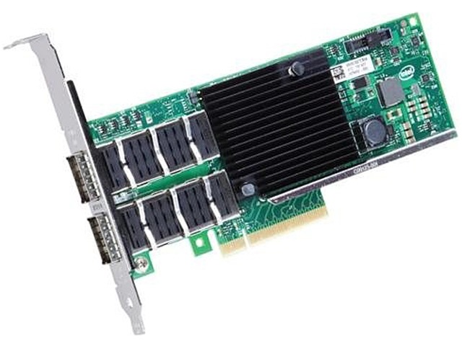

IOMMU
Background
1. dma_map(VA)
  Allocate IOVA
IOMMU
Page Table
  Update dev page table
IOVA -> PA
2. Transmit Packet
IOTLB
IOVA -> PA
3. dma_unmap(IOVA)
  Remove entry from page table
  Flush IOTLB
  Free IOVA
Notes:
To demonstrate how IOMMU is used via the DMA API, let’s follow a sent a packet.
1. First the nic driver dma_map-s the packet(1). the operation creates a new io virtual address(2), the I/O page table is populated(3 + 4), thats the the blue box on the slides. The red va and yellow IOVA point to the same physical address(5).
2. Second(6), the nic reads the packet using the IOVA(7) and the packet is sent.When the IOVA is accessed the IOTLB is updated.(8)The IOTLB is a small translation (*)
cache just like the TLB in the MMU.(9) (*)
3. Third(10), When the packet has been sent. The packet is dma_unmapped. unmap (11)
removes the translation from the devices page table(12), flushes (13) the entry in the IO/TLB(14 +15). Now the NIC cant access the physical page anymore (3:00)
. (+)The problem is that IOMMU is completely inadequate to prevent DMA attacks

Slide 8
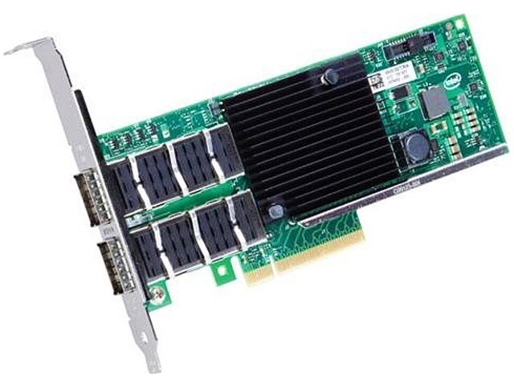
IOMMU & (no)Security
Background
NIC needs to access
4KB page
NIC
CAN access
struct skb_shared_info {}
Notes:
And the reason is something that is known as the sub-page vulnerability. IOMMU granularity is of 4K pages. This means that any data co-located(1) on a page with a DMA buffer can be accessed by the device! , for example the smallest network packet is about 48B(2) so this is everything the nic needs to access and this (3) is everything the NIC can access. Each time a 48 byte packet is mapped the NIC can access the whole page. This is the sub page protection problem.(4:00)

Slide 9
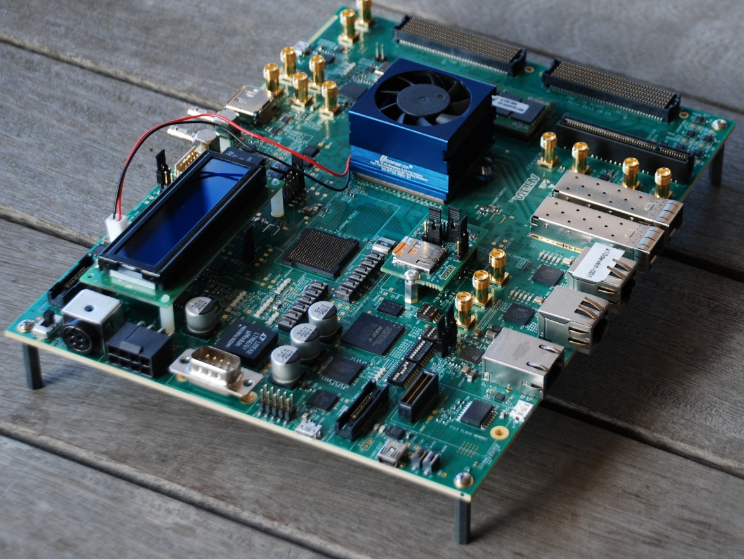
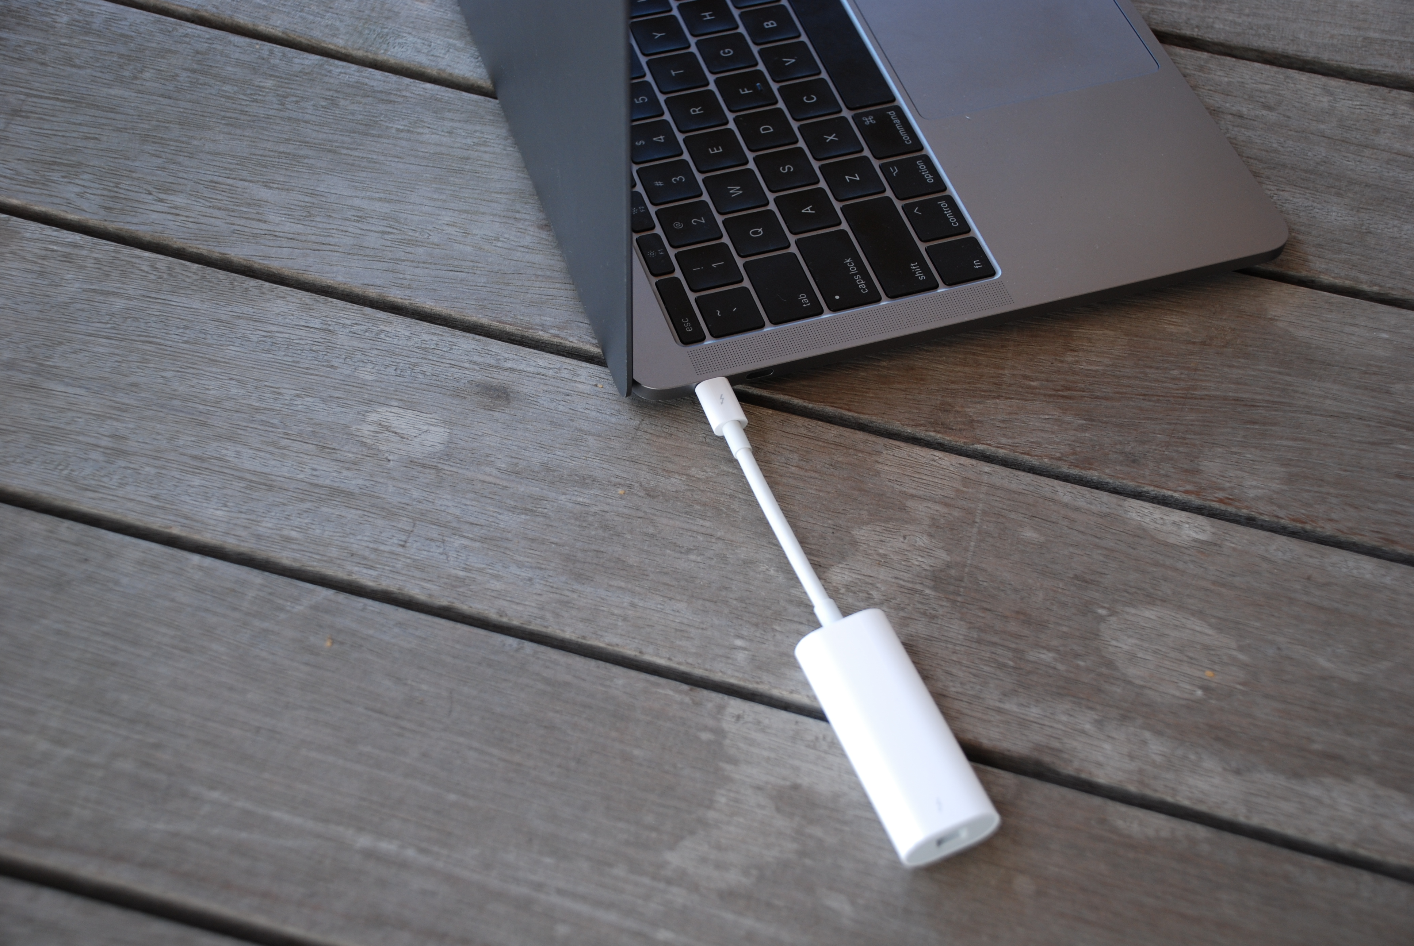
IOMMU subverting DMA attacks
Background
IOMMU is inadequate to prevent DMA attacks.
A DMA Capable malicious device.
  Kupfer 2018
    Storage Protocols
  Thunderclap 2019 (http://thunderclap.io/)
    E1000 Emulation
Notes:
And Indeeded In recent years there were a couple of dma attacks demonstrated that took advantage of this vulnerability. Now we know that our systems are vulnerable, but we don’t know what is the extent of the danger. And we are here to solve this problem we build tools that can detect DMA vulnerabilities in run-time and in static analysis.

Slide 10
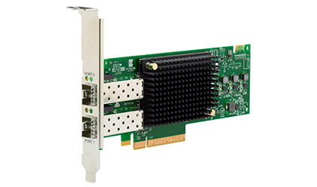

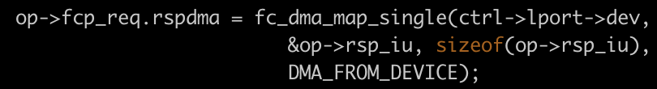
Example
Broadcom LPe32002 FC HBA
__nvme_fc_init_request
96B
32B
Notes:
First lets discuss a specific example, in a generic nvme over fc driver. This Broadcom FC device is one example of a relevant device. When I/O starts there are commands that are sent to the device, and a dialog via DMA is initiated. To acomplish this, driver maps this (+) data structure which contains the command 96 Bytes to be read by the client. And also (+) this response a data structure of 32 Bytes to be written by the client.

Slide 11
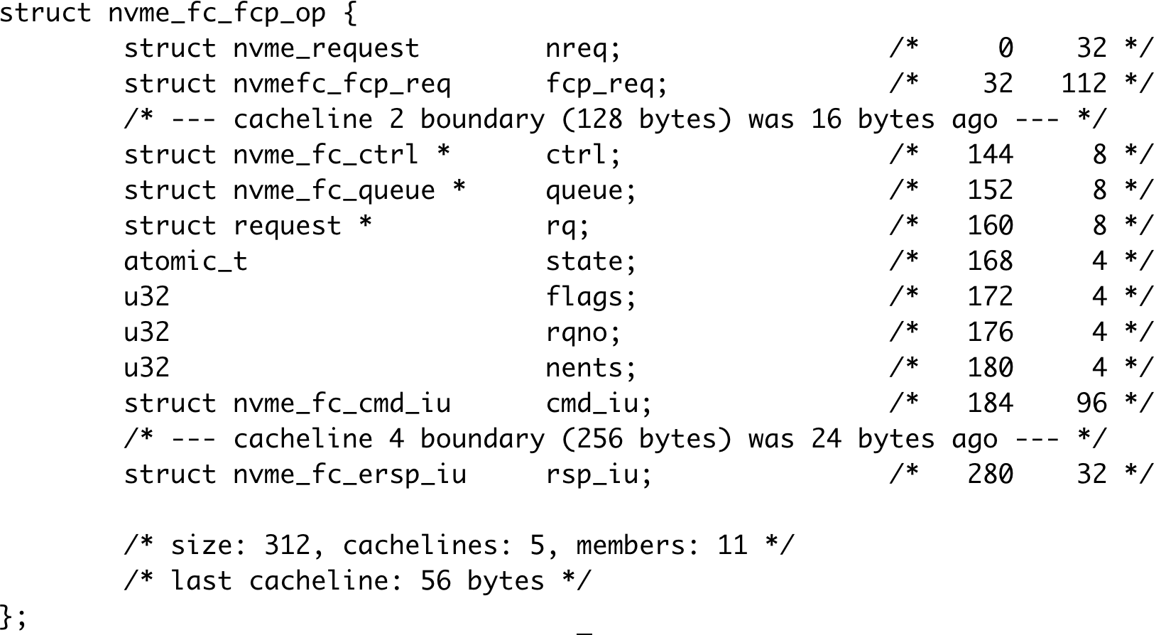
Example
32B
Notes:
First lets discuss a specific example, in a generic nvme over fc driver. This Broadcom FC device is one example of a relevant device. When I/O starts there are commands that are sent to the device, and a dialog via DMA is initiated. To acomplish this, driver maps this (+) data structure which contains the command 96 Bytes to be read by the client. And also (+) this response a data structure of 32 Bytes to be written by the client.

Slide 12
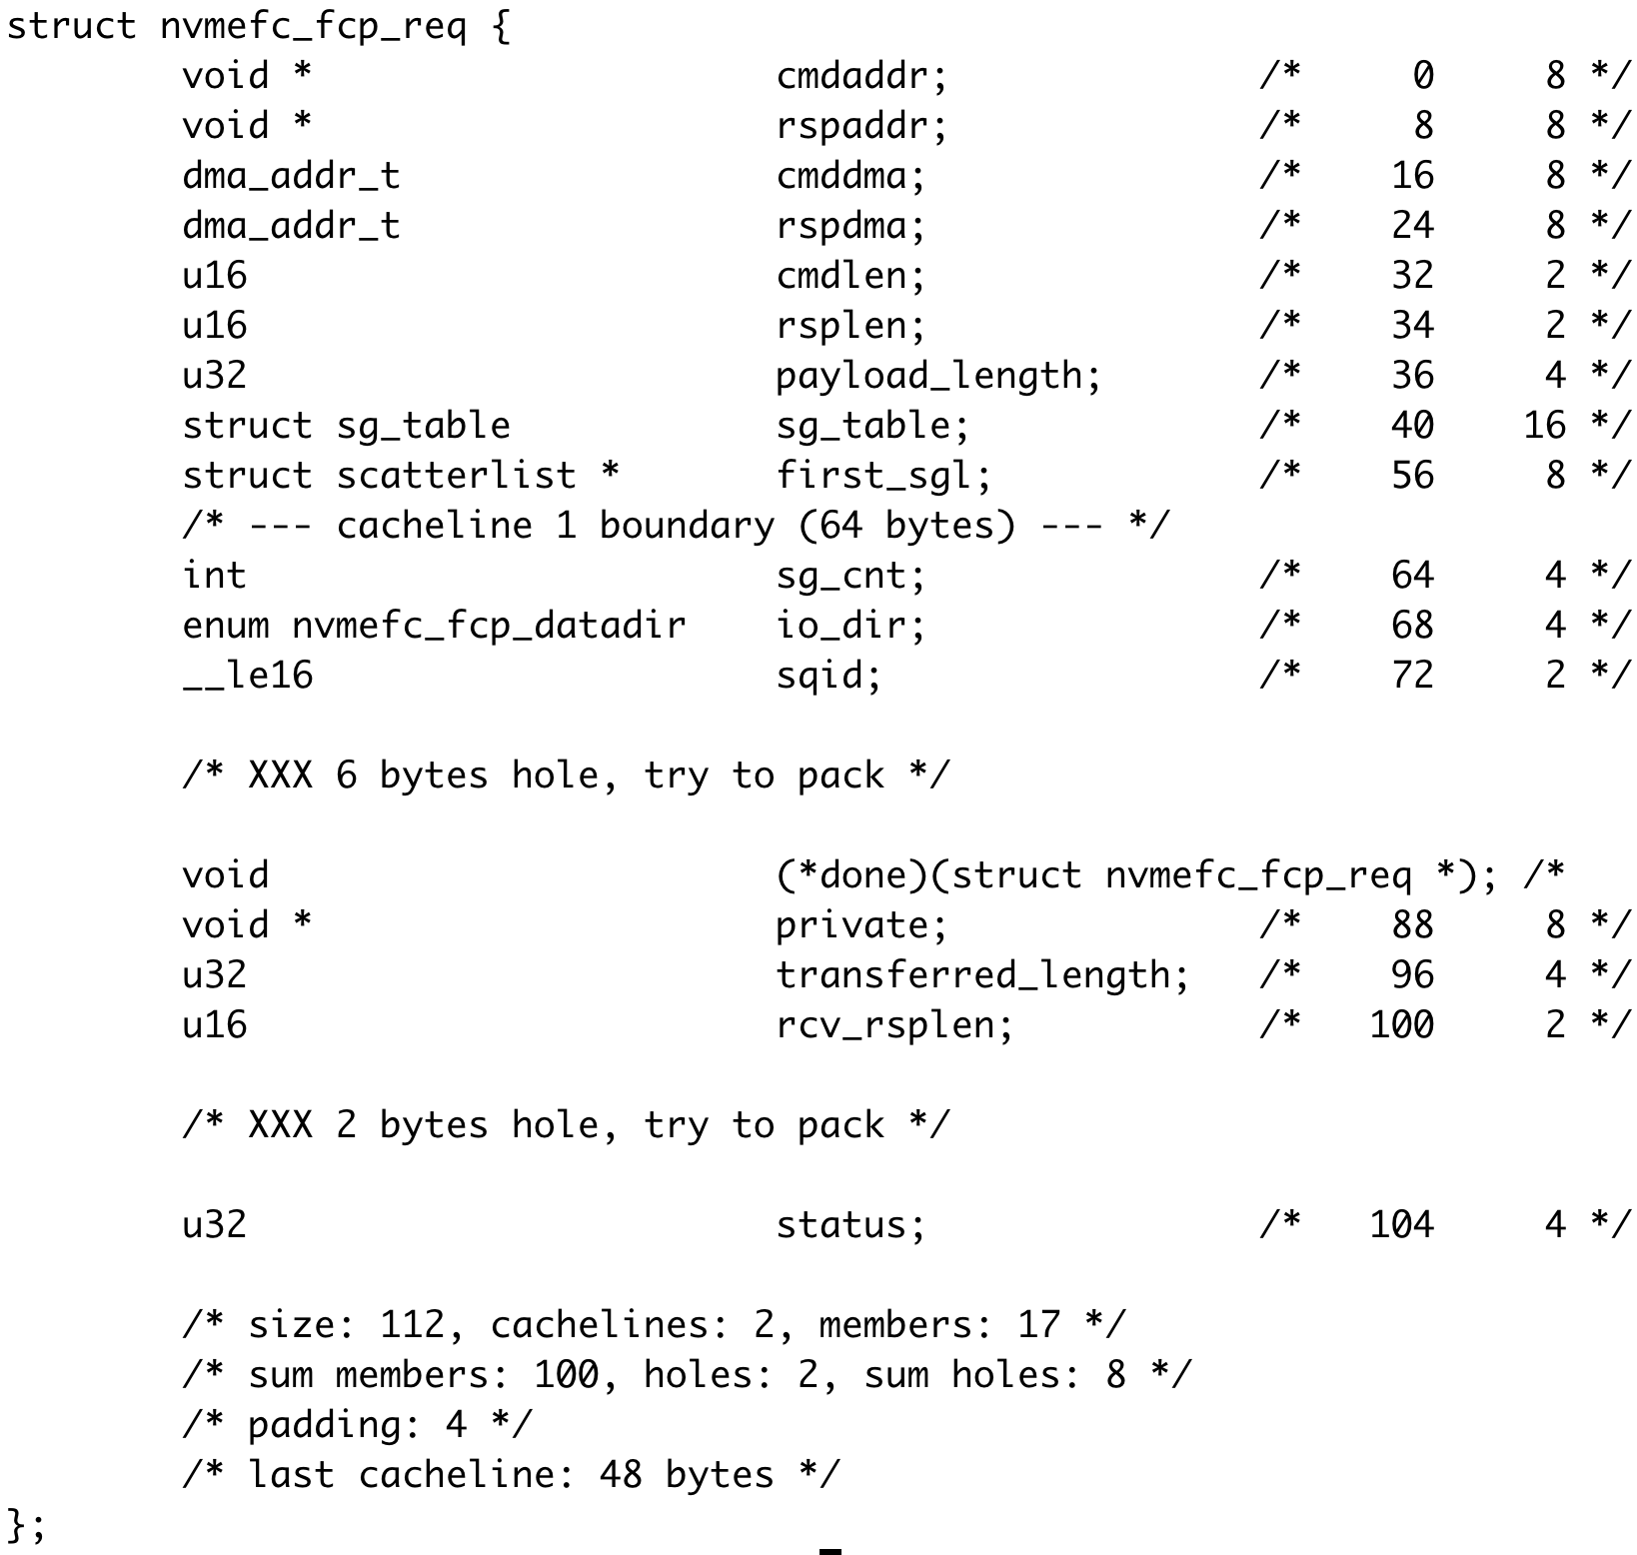
  VA
  VA
Notes:
First lets discuss a specific example, in a generic nvme over fc driver. This Broadcom FC device is one example of a relevant device. When I/O starts there are commands that are sent to the device, and a dialog via DMA is initiated. To acomplish this, driver maps this (+) data structure which contains the command 96 Bytes to be read by the client. And also (+) this response a data structure of 32 Bytes to be written by the client.

Slide 13
Problem: protection @ DMA API level
• Allows device to access buffer only between map/unmap
• Which inherently imposes per-DMA overhead
◦ If zero-copy with IOMMU map+unmap
(state-of-the practice = Linux “strict” IOMMU protection)
▪ Then unmap hampers performance & insecure (no sub-page protection)
◦ If copy
(state-of-the-art = shadow buffers [ASPLOS’16])
▪ Then copy hampers performance
New approach, change the API semantics!
Notes:
We finally realized that the root cause of all these problems, IS the DMA API, (1) it allows a device to access a memory buffer only during the time interval at which the buffer is mapped. (2) This inherently means that we must do *some* work on map/unmap: be it the zero-copy (3) with IOMMU(4) update per packet, or (5); copy, with shadow buffers, which gets rid of the IOMMU overhead but replaces it with copying overhead(6). No matter what you do, providing protection at the DMA API level will always come at a price(7). So we thought (8): maybe we can we relax this API constraint? (8:15)

Slide 14
NIC
can modify
DMA unmap
• Key idea
◦ Data remains mutable beyond DMA unmap
• Everything device writes after unmap
◦ Was also able to write before
• To be safe, ensure that
◦ Data remains unchanged after CPU reads it
CPU read
NIC
Can’t
modify
• Which standard network stacks do in any case!
◦ When copying data to user
Time
Memory
Notes:
Our idea in this work is to keep the data mutable by the device even after a DMA unmap. (1+2) This is OK, because anything the device writes after the unmap, it could have just as well written before. The real security guarantee we need is that once the CPU reads a byte(3), the device (4)must no longer be able to change it. Fortunately, for most bytes, this is actually *already* taken care of, because the network stack will copy the data when send or receive system calls are called. (9:00)

Slide 15
Implementation
• Revise network stack to use a new allocator, called “DAMN”
◦ DMA-aware malloc for networking
• Each allocated page permanently mapped to IOVA
◦ map: return IOVA / unamp : NOP.
• (De)allocation
◦ Alloc: via functions analogous to standard Linux’s alloc_page / kmalloc
◦ Free: via Linux’s standard free_page / kfree
◦ Released upon memory pressure via standard Linux interface (“shrinker”)
Notes:
We have implemented our solution in kernel 4.7 and recently ported to the newer kernel 4.14.
We have added a new memory allocator (1). DAMN - dma aware malloc for networking (2)
We have modified the Linux network stack, specifically TCP and UDP to use our dedicated memory allocator.
(3) Each page given by damn is already dam -mapped. (4)Damn allocation API (5)is analogous to that of the linux kernel. (6)The pages can be freed with standard kfree/free_page. We had to update the kernel memory management code to support this . We also support (7)the shrinker mechanism that may reclaim pages in the case of memory pressure.
(8) We encode the IOVA, the I/O virtual address with additional (9)information to improve performance. More details in the paper (10+11).
(12) And finally in order to prevent TOCTOU, we modify accessor functions that touch the packet payload. (13) The packet in linux is represented by an sk_buff struct or skb. This skb is accessed via special accessors because it is often discontiguous and built with scatter gather vectors. (11:00)

Slide 16
More Reading
DAMN [ASPLOS’18]
http://www.cs.technion.ac.il/~dan/papers/damn-asplos-2018.pdf
Copy Protection [ASPLOS’16]
http://www.cs.tau.ac.il/~mad/publications/asplos2016-iommu.pdf
Thunderclap [NDSS’19]
http://thunderclap.io/
On DMA vulnerabiliites in the presence of an IOMMU [EUROSYS’21]
http://www.cs.technion.ac.il/~dan/papers/ioatk-eurosys-2021.pdf
https://www.youtube.com/watch?v=W9rGWzDKGKk

Slide 17
MAIO
Rethinking zero-copy

Slide 18

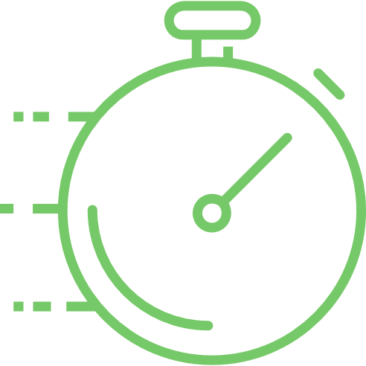


User-space Networking
Sockets
  Kernel Bypass
import socket /* Import */
s = socket.socket(socket.AF_INET,socket.SOCK_STREAM) /* Create */
s.connect((destination, port)) /* Connect - Routing */
s.sendall('Hello, world’) /* Send - TCP/IP */
Notes:
When building a network facing application there are essentially two choices. Either use ubiquitous sockets. (+) Which is as simple as importing a librarian and creating a socket, (+) connecting (+) and sending your I/O.
You get all the robust Kernel infrastructure of Routing, address resolution and transport protocols like TCP. And on the other hand (+) you can hire a team of engineers to maintain a volatile kernel bypass implementation(+).
And you make this choice because one is (+)fast and the other is slow.

Slide 19
Zero-Copy Network I/O
The Problem:
  Network packet arrival order is random!
  Kernel provides memory for I/O
  Packet Arrives
  Data copied to correct process.
  Storage\GPU\etc… data arrival order is known.
  Process asks for I/O
  User provides buffer
  Data arrives
Notes:
Well you might ask yourself why Zero-Copy is such a problem.
In networking the + packet arrival order is random, in the sense that you don’t know when the next packet will arrive and where is it going.
Accordingly the receive process is as following. + <> then + <> and then + ().
With storage devices GPUs and other devices he order of I/O operations is known.
First + <>…

Slide 20
Zero-Copy Network I/O
Challenges posed:
  Isolation
  Isolation
  Isolation
Kernel memory from user
Packet headers from user
Different users
Notes:
Simply sharing memory between the kernel and the user. is infeasible because + u can’t give the user access to kernels memory its simply not secure. + And even with I/O pages you should not allow the user the option of modifying packet headers while its traversing the network stack.
And Finally we need to isolate the users from each other.

Slide 21
Zero-Copy Approaches
Dynamic Remapping
MSG_ZERO_COPY, TCP_MMAP, COW (FreeBSD)
Kernel Bypass
DPDK, NetMap, AF_XDP
Limited use-case
splice, sendfile, SOCKMAP
Specialized HW
RDMA – iWARP, Infiniband, ROCE
Shared Memory
No
Notes:
There were numerous attempts for achieving zero-copy. And they all fall into 5 categories. + Dynamic remapping which implies modifying the page-tables in data path, in recent years Google have gone by this path.
+ Kernel bypass, like DPDK - which is used by Velocloud, NSX-T and others in VMware. There are limited use case system calls, which can alleviate some of the pain in some of the time.+ Specialised HW witch implements Remote DMA protocols and their apis, this is most often seen in HPC environments. + And lastly there were a couple of shared memory based proposals that are better left forgotten.

Slide 22
Zero-Copy with Shared Memory
The Solution: Memory Segmentation - I/O (only) Pages*
  MAIO pages used for I/O
  Packet arrives
  Data page delivered to process
How does this help?!
  Isolation - Kernel Memory: No Kernel data is ever located on an I/O page
    All data is by/for the user
  Isolation - between processes: HW supports is needed (resolves the randomness).
    Intel ADQ
    NVIDIA QP (DPDK Bifurcated driver)
    Virtualization paravirt-drivers (virtio, netvsc, vmxnet)
  Isolation - control path: Scatter-Gather RX
Notes:
Looking at this the solution was obvious. We have to do shared memory right.
We create e third type of memory its not User and not kernel but I/O memory, each user can have its own. In this case + <>.
+ So how does this solve the problems that we mentioned?

Slide 23
Zero-Copy with Shared Memory
Limitations:
Zero-Copy semantics vs Copy Semantics
      Buffers change ownership.
          On TX the buffer is owned by Kernel
      No serialisation/linearisation.
          On RX the buffer size is limited by MTU*
Notes:
The limitations are that zero-copy semantics are inherently different. When transmitting the sent buffer no longer belongs to the user and must not be accessed. On RX the received buffers are usually scatter gather lists of MTU sized buffers and the alignment is provided by the driver.

Slide 24
MAIO in practice
    Sockets
    MAIO Sockets
import socket /* Import */
s = socket.socket(socket.AF_INET,socket.SOCK_STREAM) /* Create */
s.connect((destination, port)) /* Connect - Routing */
s.sendall('Hello, world’) /* Send - TCP/IP */
void *cache = init_hp_memory(PAGE_CNT); /*Init MAIO pages */
int idx = create_connected_socket(dip, port); /* Create a TCP socket */
char *buffer = alloc_page(cache); /* get a 4K buffer from HP */
init_tcp_ring(idx, cache); /* init the Async TX ring */
send_buffer(idx, buffer, len, flags);
get_buffer_state(buffer); /* get the page/chunk state*/
Notes:
API under the hood next.
Init memoy – 1. dedicated memory management for I/O 2.our choice Huge pages for performance and more metadata.
Create and connect flags are default. 1) kernel socket 2) and connect 3) idx is not a fd it’s a MAIO.
Use cache to get MAIO page
Create async I/O ring – 1.) io_uring 2.) creates a kern thread that uses kern socket.
Send : 1.) post a user buffer on the ring.
Check the page ownership after some time.

Slide 25
Kernel Memory Segmentation
What is it?
  Memory Intended for a specific use case.
  Allocate with a dedicated allocator.
  Mange and Free with standard
  put/page operations.
include/linux/mm_types.h
struct page {} (64B metadata)
get/put_page()
compound_head()
page_ref_inc
Notes:
Kernel support memory segmentation.
In kernel
Dedicated allocator a cache
But free and ref counting are standard.
Need to get back to MAIO alloc.
Struct page -1. exactly 64B for each 4K. 2) HP 2MB are a contig array of 512 pages. Where the first is head rest are tail 3) can hide additional MD.
API you need is 1. get/put 2. compound head 3. page_ref_inc will cause bugs.

Slide 26
Kernel Memory Segmentation
What is it?
  Memory Intended for a specific use case.
  Allocate with dedicated allocator.
  Mange and Free with standard
  put/page operations.
    Example DEV_PAGEMAP
    static inline void put_page(struct page *page)
    {
    page = compound_head(page);
    if (put_devmap_managed_page(page))
    return;
    if (put_page_testzero(page))
    __put_page(page);
    }
Notes:
Actualy we already have one example DEV_PAGEMAP
In put page we have dedicated handling.
MAIO with HP is different because unions of tail page and devmap overlap. Mixing is aquestion.

Slide 27
HugePages and Kernel Memory Segmentation
MAIO uses 2MB HP (compound pages).
First TailPage holds uaddr for fast memory translation and is_maio_page
struct { /* Tail pages of compound page */
unsigned long compound_head; /* Bit zero is set */
/* First tail page only */
unsigned char compound_dtor;
unsigned char compound_order;
u16 elem_order; /* Plug a 2B Hole*/
atomic_t compound_mapcount;
unsigned int compound_nr; /* 1 << compound_order */
/* 4B Hole*/
unsigned long uaddr; /* Uaddr*/
};
Notes:
We use 2MB HP and compound.
In union for first tail page
We hide uaddr kernel cant use user address in I/O
Identifies maio page. 1.) API works on each page rather than on the head. 2) head is out of I/O 3) tail is usually rc=0
And elem order for potential – sub compounding.

Slide 28
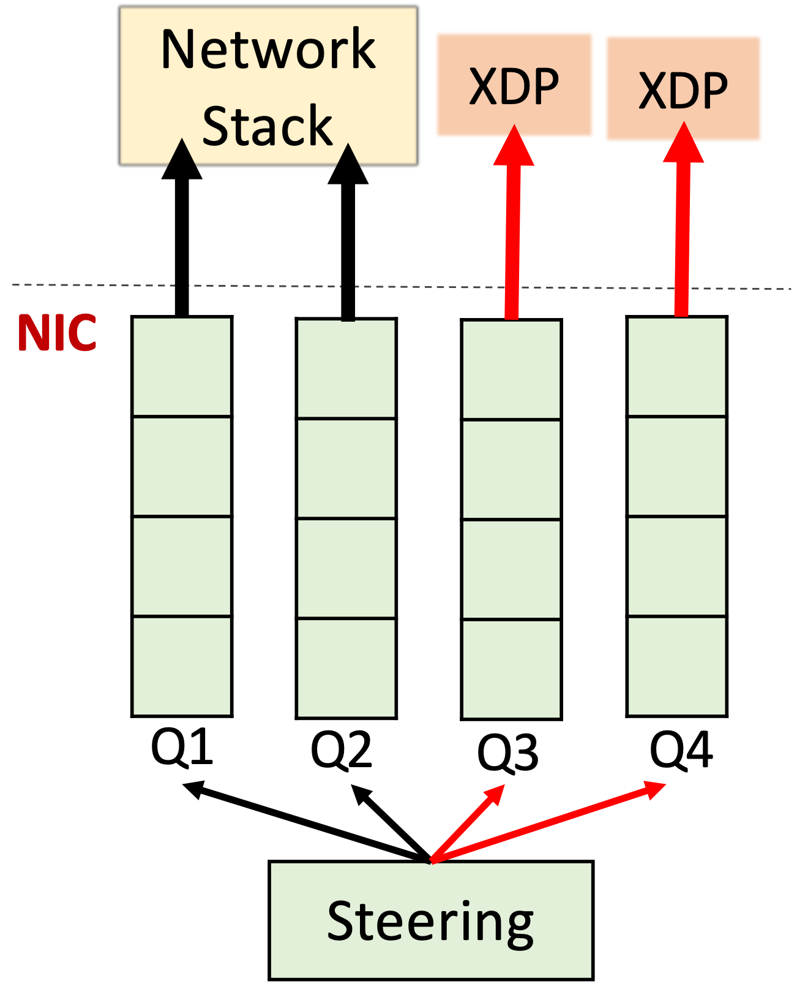
Next Steps
Guest App
Guest OS
Upstreaming
  Linux Kernel
  User Library
Dethrone SRIOV
  QEMU is just another process
  Nested MAIO support
App
DPDK
QEMU
Kernel
MAIO
MAIO

Slide 29
Next Steps
Upstreaming
  Linux Kernel
  User Library
Dethrone SRIOV
  QEMU is just another process
  Nested MAIO support
Efficient Copy Semantics with Intel SIMD - SSE (?)
  Vector operations are fast
  6 memory channels
MAIO
BACK END
App
Kernel
MAIO
MAIO

Slide 30
Memory Segmentation Discussion
Basic Premise:
Assign role to a page
Allocate Intentionally but don’t worry about freeing
Get secure I/O at +100Gb/s
Else:
1. Use add/remove transient properties for each buffer…

Slide 31
Github
Kernel & User Lib: git@github.com:Markuze/maio_rfc.git
Email : amarkuze@vmware.com

Slide 32
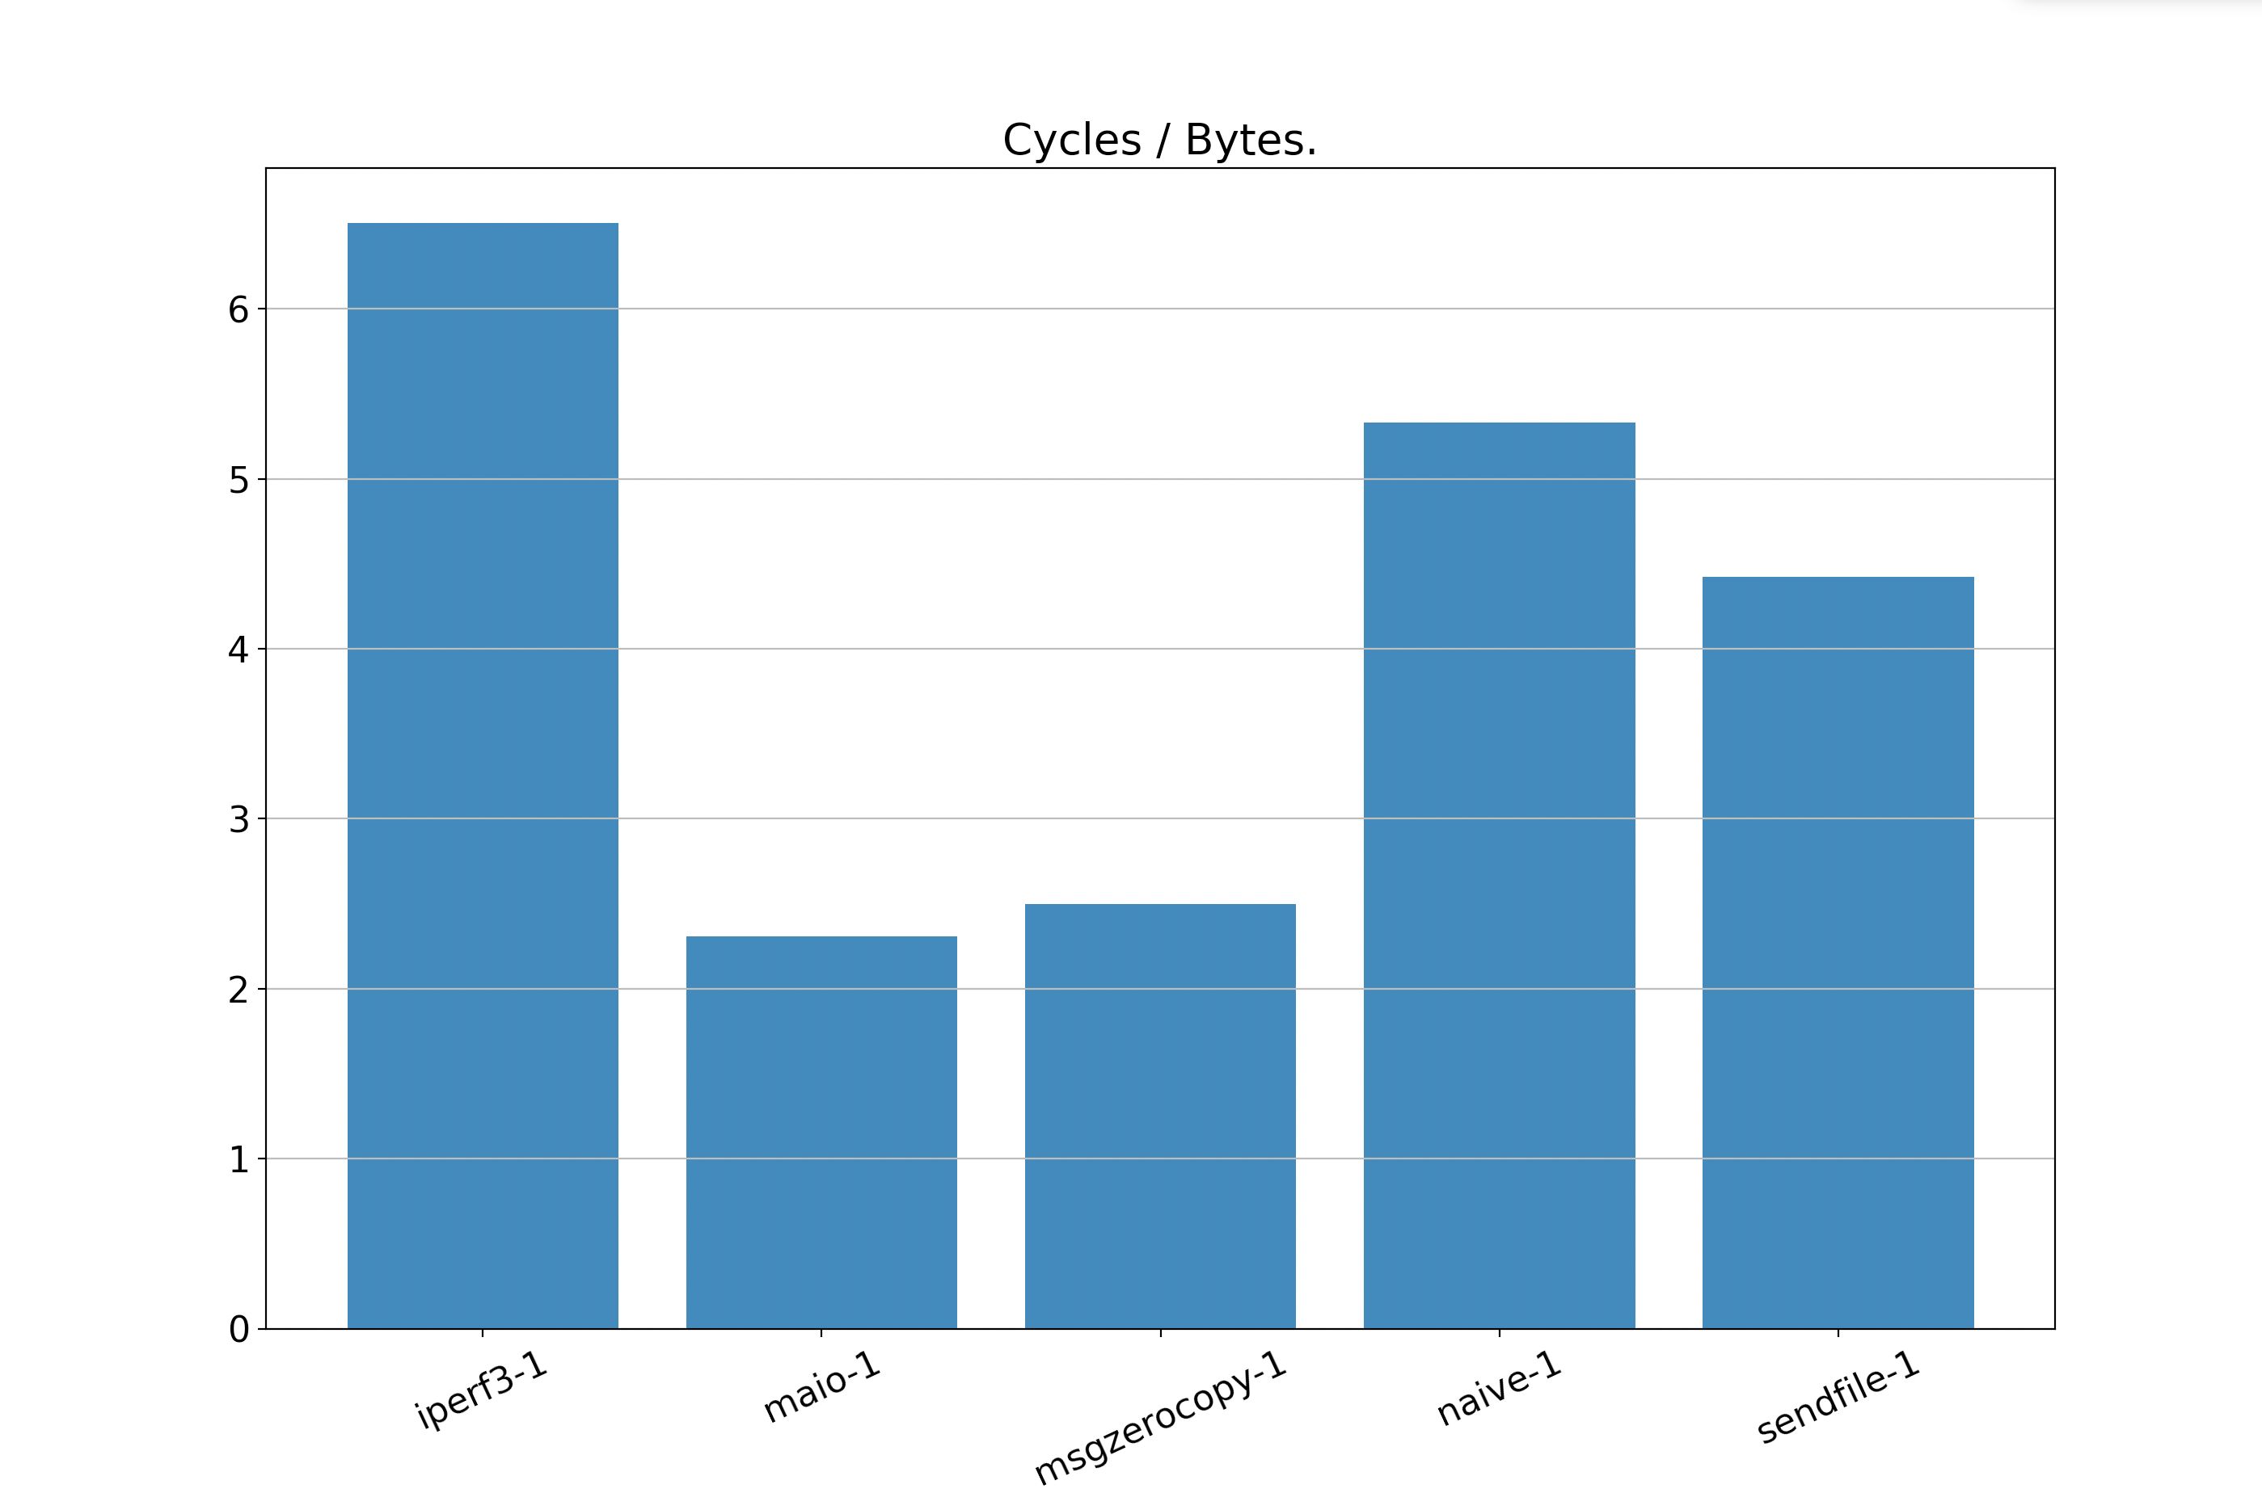
Comparing TX loop of 16KB buffers
6.50
5.33
16 Core VM on GCP
32Gb/s Egress
64 GB Memory
16K * 2K buffers with 1 Thread
Cycles/Byte – Lower is Better
4.42
2.31
+8%
2.49
Notes:
Setup info.
Naïve limited by BW and you often get weird hickups in performance.
better comparison is cycles/byte.
We measure the overall system cpu – idle ticks /proc/stat and the overall bytes sent.
+ introduce one by one
+ why only 8% send page vs send_msg
No sure can handle bigger buffers
Send_msg already has zero-copy which is incomnpatible.

Slide 33
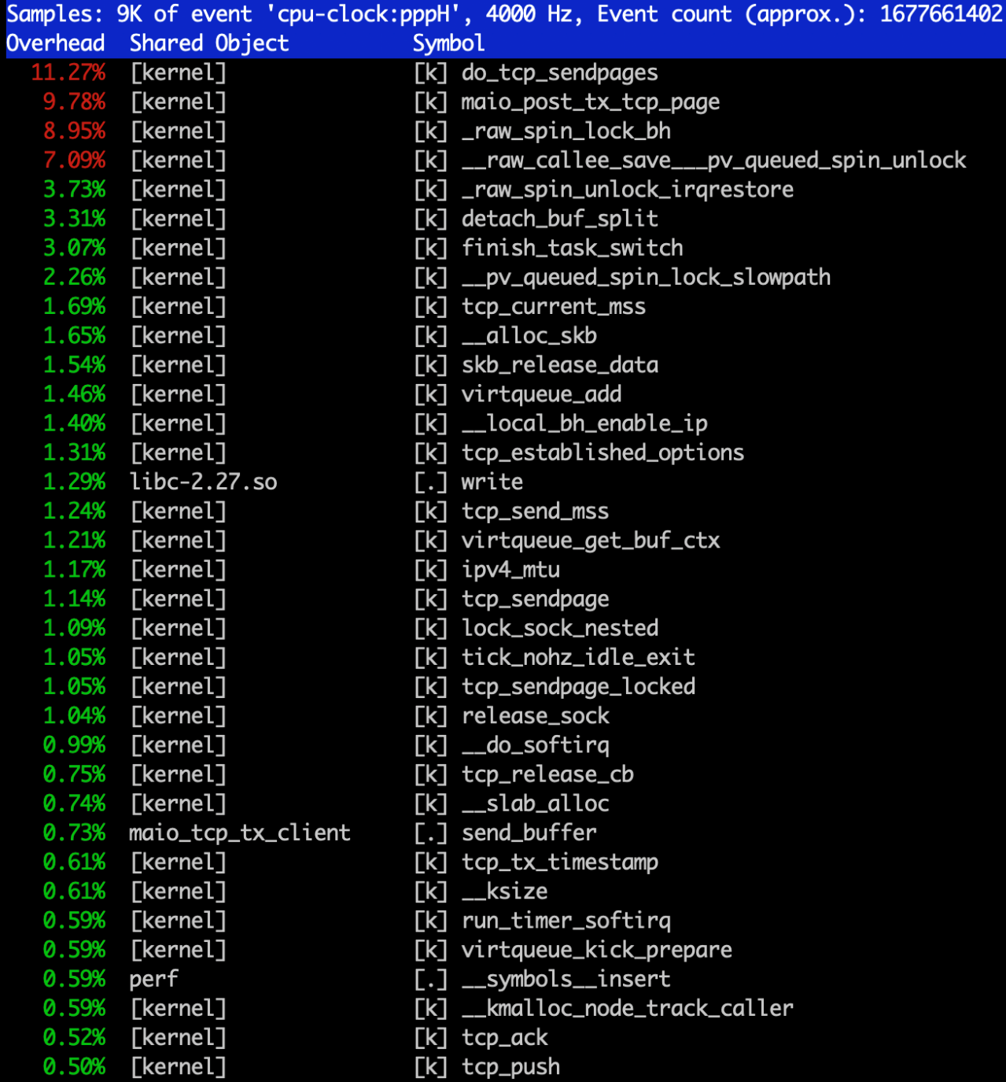
Comparing TX loop of 16KB buffers
1 Thread
16 Core VM on GCP
32Gb/s Egress
64 GB Memory
16K * 2K buffers with 1 Thread
Cycles/Byte – Lower is Better
MAIO Send
Notes:
We see here the perf breakdown – and indeed do_tcp_sendpages is the heaviest hitter.
Most of the work is on the async thread.
User barely does any work. – When Q is full it sleeps.

Slide 34
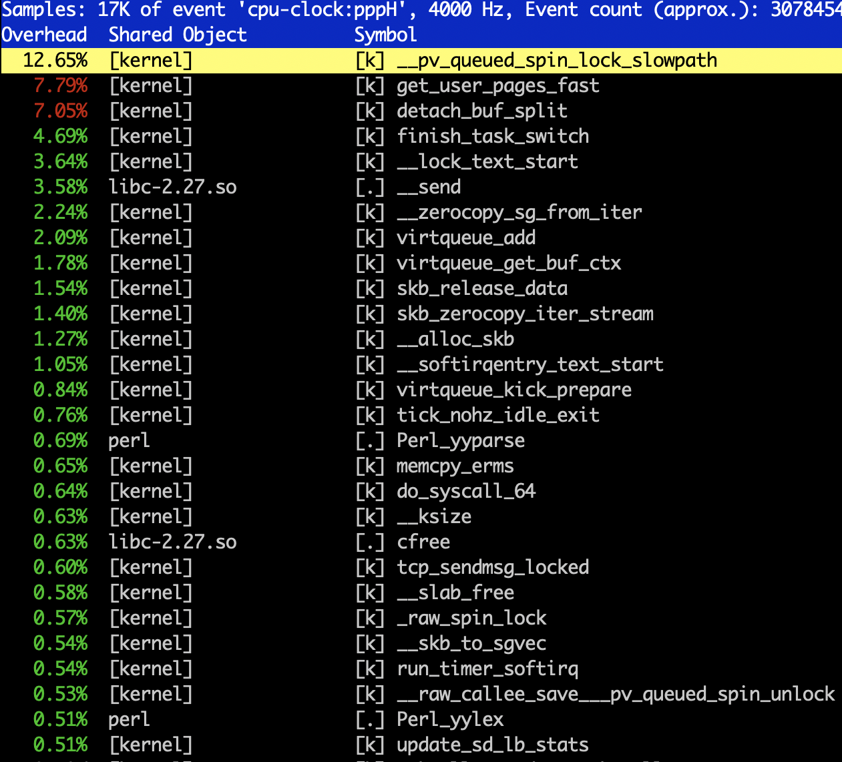
Comparing TX loop of 16KB buffers
1 Thread
16 Core VM on GCP
32Gb/s Egress
64 GB Memory
16K * 2K buffers with 1 Thread
Cycles/Byte – Lower is Better
MSG_ZEROCOPY

Slide 35
HugePages and MAIO
void *cache = init_hp_memory(PAGE_CNT); /*Init MAIO pages */
Get PAGE_CNT of 2MB HP
Kernel: Create a Memory Translation Table.
8B entry * 1 HP (2MB)
Kernel: Set page[1]->uaddr
Init custom memory management. (linked list of 4K and 16K)
Head Page is not used for I/O as ref count never 0.
Tail Pages have RC = 0 while in user space.
get/put_page operate on Tail Page not the Head Page.

Slide 36
Socket Managment
int idx = create_connected_socket(dip, port); /* Create a TCP socket */
Kernel: Create a Kernel TCP socket.
Kernel: Connect to destination.
Returns internal identifier for the socket.
Notes:
Once we have memory segmentation. The rest is simple.
Kernel sockets

Slide 37
Async TX Ring
init_tcp_ring(idx, cache); /* init the Async TX ring */
Allocate and Init a ring for async TX. Uses cache.
Kernel: affiliate socket and async ring. Uses idx.
Kernel: Create a kernel thread
Notes:
Async TX ring is not a new concept but useful.
1. Alloc ring from shared mem using cache.
Create Kernel thread
Affiliate the kernel socket and kernel thread.

Slide 38
Zero-Copy TCP TX
send_buffer(idx, buffer, len, flags);
Post a MAIO buffer on the ring[idx]
Wake-Up the kernel Thread (unless flags have MORE set)
Async TX Thread
Poll the ring[idx]
Use MTT to get kernel address
Send the buffer with tcp_sendpage
Notes:
Post buffer and wake up thread.
1. Allow batching.

Slide 39
Page State TX
  Who owns a sent buffer?
    RC handles correct state. page_ref_inc on each TX.
  Options.
    Socket notification (sock_zerocopy_callback/ubuf_info)
    Opportunistic state management on Head Page
        Transition 0 – 1.
    Sys-call to query page_ref_cnt
get_page
Head Page – shadow map of 4KB pages.
  512 4K pages in 2MB
  8B for each 4K Page on Head Page
Notes:
The question of ownership, you can’t modify until kernel is done.
On each send the page rc is increased.
This is wrong + yes get page
Couple of options,
msg_zerocopy cb and ubuf in general
Oprtunistic management using head page on 1-0 transition. Have 8B per 4K page – subject to race. New TX with free.
Sys call to get Page RC.

Slide 40
Zero-Copy TCP RX
tcp_receive_sg(idx, io_vec, cache)
Collect a sg list from the TCP socket
kernel: Translate kernel address to user address using page->uaddr
Kernel: refill kernel pages
Kernel Modifications
skb_zerocopy_iter_stream modification skb_zerocopy_sg_from_iter (tcp_mmap)
A MAIO implemenmtation: MAIO allocator for RX ring
  Magazine allocator
Driver modification (AF_XDP)

Slide 41
Page State RX
  Who owns the received buffer?
    RC handles correct state.
  Options.
    Opportunistic state management on Head Page
    One RX per page (XDP)
        RX buffer ownership transferred on RX
  Who owns the mixed-use page?

Slide 42
DPDK MAIO-PMD
  Why?
  HW Agnostic
  Standard Linux Tools
  Hybrid use-case
      Decrypt in user-space and plain text via network stack
  How?
  RX ring
  Direct xmit (pktgen)
  Already HP and own memory mangment

